Slide 1
Integrated Climate Change Adaptation (CCA) and Flood Risk management Strategy and Plan for the Drin River Basin
Draft
Flood Risk Management Strategy for the Drin River Basin 2025 - 2035
Sept. 2024

Slide 2
Table of Contents
Conceptual Approach of FRM Strategy
Drin FRM Strategy 2025 – 2035
Consultation process*

Slide 3
Conceptual Approach of
FRM Strategy

Slide 4
Conceptual Approach of FRM Strategy & FRM Action Plan

Slide 5
Drin FRM Strategy – Axis of Action
According to the institutional framework, existing enablers, and barriers, the following Axis of Action were recommended (Feasible Technical & Economical)
Axe n° 1
Ensure Flood Risk Awareness, Preparedness & Good Governance
Axe n° 3
Axe n° 2
Incentive Nature Based Solutions & No-Regret Climate Adaptation Measures
Promote Equitable Transboundary Cooperation and Bottom-Up Community Based Projects
Incorporate the FRM Policies on Agriculture and Energy (Hydropower) Sectors

Slide 6
Draft Formulation of the FRM STRATEGY
VISION
STRATEGIC
GOALS
STRATEGIC OBJECTIVES
Drin’s Basin Communities are Prepared to Cope against extreme Hydro-Climatic events (100 RP)
Short-Term: Make the Drin Basin’s Communities Resilient and able to Adapt to Climate Change Challenges
Each Strategic Goal includes a list of Strategic Objectives
Ensure Flood Risk Awareness, Preparedness & Good Governance
Environmental & Prevention Approach to FRM
MISSION
Maximize Fundings
Bottom-Up & Participatory Approach

Slide 7
Drin FRM Strategy
2025 – 2035
(Up-graded according to the results of FRM Action Plan)

Slide 8
VISION & MISSION
VISION | Long/Medium Term (2025 - 2035): Reaffirms the Shared Vision of the MoU (2011). “Coordinated Integrated Management of the Shared Water Resources as a Means to ………… Promote Sustainable Development across the Drin Basin”
 | Short-Term (2025 - 2030): Make the Drin Basin’s Communities Resilient and able to Adapt to Climate Change Challenges
MISSION | Drin’s Basin Communities are Prepared to Cope against extreme Hydro-Climatic events (100 Years RP)
Oriented to Strengthening the Resilience of
Drin’s Basin Communities)

Slide 9
STRATEGIC GOALS & STRATEGIC OBJECTIVES
The VISION & MISSION are underpinned by four (4) Strategic Goals & Strategic Objectives
STRATEGIC GOALS & STRATEGIC OBJECTIVES (By 2030) | ENSURE FLOOD RISK AWARENESS, PREPAREDNESS & GOOD GOVERNANCE Improving the transboundary Drin Flood Forecasting and Early Warning System to ensure timely and accurate alerts by 2030
 | INCENTIVE NATURE-BASED SOLUTIONS & NO-REGRET CLIMATE ADAPTATION MEASURES Incentivize the extensive construction of Nature Based Solutions (NbS) to increase soil-water storage and reduce the peak of floods by 2030
 | PROMOTE EQUITABLE TRANSBOUNDARY COOPERATION AND BOTTOM-UP COMMUNITY BASED PROJECTS Promote and incentivize the preparation of Local/Municipal Flood Risk Management Action Plans (LFRMAP) by 2030
 | MAXIMIZE THE FINANCIAL RESOURCES Identify new financial sources & resources to fund the implementation of the Transboundary Flood Risk Management Action Plans by 2030

Slide 10
Axis of Action I: STRATEGIC GOALS & OBJECTIVES
Each Strategic Goal is underpinned by a set of Objectives and Specific Objectives
I. ENSURE FLOOD RISK AWARENESS, PREPAREDNESS & GOOD GOVERNANCE Improving the transboundary Drin Flood Forecasting and Early Warning System to ensure timely and accurate alerts by 2030
Objective 1: Strengthen the Drin/Drim-Buna/Bojana Basin FFS - Flow & Flood Forecasting System supplied by the German cooperation (GIZ) to all riparian countries (ALB, MNE, KOS, NMK) by 2030. Objective 2: Establish an operational mechanism among the riparian hydro-power companies for planned and coordinated regulation of the spillway discharges to minimize the downstream risk of flooding by 2030. Objective 3: Promote a greater Municipal integrated urban planning & land-use management to avoid the construction of new settlements, commercial, and industrial activities within high-risk flood areas by 2030.

Slide 11
Axis of Action I: SPECIFIC OBJECTIVES & OUTCOMES
Each Strategic Goals are underpinned by a set of Objectives and Sub-objectives
I. ENSURE FLOOD RISK AWARENESS, PREPAREDNESS & GOOD GOVERNANCE Improving the transboundary Drin Flood Forecasting and Early Warning System to ensure timely and accurate alerts by 2030
Objective 1: Strengthen the Drin/Drim-Buna/Bojana Basin FFS - Flow & Flood Forecasting System supplied by the German cooperation (GIZ) to all riparian countries (ALB, MNE, KOS, NMK) by 2030. Specific Objectives: Strengthen by 2028 the national FFS - Flow & Flood Forecasting Systems Strengthen by 2028 an integrated basin-wide hydro-meteorological monitoring network, including the implementation of a community-based smart-phone monitoring system Expected Outcome: Operational Flow & Flood Forecasting System in all riparian countries with timely and accurate flood forecasts along the entire Drin/Drim Buna/Bojana river network.

Slide 12
Axis of Action I: SPECIFIC OBJECTIVES & OUTCOMES
Each Strategic Goals are underpinned by a set of Objectives and Sub-objectives
I. ENSURE FLOOD RISK AWARENESS, PREPAREDNESS & GOOD GOVERNANCE Improving the transboundary Drin Flood Forecasting and Early Warning System to ensure timely and accurate alerts by 2030
Objective 2: Establish an operational mechanism among the riparian hydro-power companies for planned and coordinated regulation of the spillway discharges to minimize the downstream risk of flooding by 2030. Specific Objectives: Establish by 2028 a MoU between the riparian hydro-power companies and the key national institutions related to the integrated water resources management (IWRM), and the disaster risk management (DRM) sector to define the operational procedures for a coordinated regulation of the spillway discharges Fully integrate the hydro-power companies within the Drin/Drim-Buna/Bojana Basin FFS - Flow & Flood Forecasting System Expected Outcome: Coordinated operational management of the hydropower reservoirs along the Drin Cascade, from Vau i Dejes (ALB) up to Globochica (NMK), including the spillway discharges.

Slide 13
Axis of Action I: SPECIFIC OBJECTIVES & OUTCOMES
Each Strategic Goals are underpinned by a set of Objectives and Sub-objectives
I. ENSURE FLOOD RISK AWARENESS, PREPAREDNESS & GOOD GOVERNANCE Improving the transboundary Drin Flood Forecasting and Early Warning System to ensure timely and accurate alerts by 2030
Objective 3: Promote a greater Municipal integrated urban planning & land-use management to avoid the construction of new settlements, commercial, and industrial activities within high-risk flood areas by 2030. Specific Objectives: Promote the preparation of the Municipal FRM Action Plans involving the Local Civil Protection Committees (communities) Establish a control mechanism, severe sanctions, and fines, including the demolition of non-authorized structures located within the high-risk flood areas Strengthen the Municipalities on integrated urban planning & land-use management Promote guidelines, and public awareness to local communities based on the Municipal FRM Action Plans Expected Outcome: Assimilation of the Flood Risk Maps within the Local Development Plans of 50 Municipalities, forbidding the construction of new settlements, commercial, and industrial activities within high-risk flood areas.

Slide 14
Axis of Action II: STRATEGIC GOALS & OBJECTIVES
Each Strategic Goal is underpinned by a set of Objectives and Specific Objectives
II. INCENTIVE NATURE-BASED SOLUTIONS & NO-REGRET CLIMATE ADAPTATION MEASURES Incentivize the extensive construction of Nature Based Solutions (NbS) to increase soil-water storage and reduce the peak of floods by 2030
Objective 1: Incentivize economically the afforestation and the naturalization of the upper sub-basins by 2030. Objective 2: Incentivize economically the recovery, naturalization, conservation, and ecological revitalization of the wetlands, coastal lagoons, and marshlands in the lower Drin Buna/Bojana area by 2030.

Slide 15
Axis of Action II: SPECIFIC OBJECTIVES & OUTCOMES
Each Strategic Goals are underpinned by a set of Objectives and Sub-objectives
II. INCENTIVE NATURE-BASED SOLUTIONS & NO-REGRET CLIMATE ADAPTATION MEASURES Incentivize the extensive construction of Nature Based Solutions (NbS) to increase soil-water storage and reduce the peak of floods by 2030
Objective 1: Incentivize economically the afforestation and the naturalization of the upper sub-basins by 2030. Specific Objectives: Promote awareness of the social and economic benefits of the ecosystem services by 2028. Establish partnership mechanisms for downstream beneficiaries to pay for upstream natural investments that reduce the peaks of the floods (Water Funds) by 2028. Promote the construction of retention ponds, small dams, inland wetlands, and other nature-based solutions involving the local communities. Expected Outcome: Construction of 250 NbS in the upper basin, including the afforestation of 4.000 ha

Slide 16
Axis of Action II: SPECIFIC OBJECTIVES & OUTCOMES
Each Strategic Goals are underpinned by a set of Objectives and Sub-objectives
II. INCENTIVE NATURE-BASED SOLUTIONS & NO-REGRET CLIMATE ADAPTATION MEASURES Incentivize the extensive construction of Nature Based Solutions (NbS) to increase soil-water storage and reduce the peak of floods by 2030
Objective 2: Incentivize economically the recovery, naturalization, conservation, and ecological revitalization of wetlands, coastal lagoons, and marshlands in the lower Drin Buna/Bojana area by 2030. Specific Objectives: Promote awareness of the social and economic benefits of well-protected freshwater ecosystems to become renowned eco-tourist destinations. Promote the natural restoration of wetlands and coastal lagoons for the temporary storage of water volumes, and controlled discharge involving the local communities. Promote the maintenance and cleaning of the 2ndary drainage network, river embankments, and other nature-based solutions involving the local communities. Promote the establishment of agritourism and other economic nature-based activities that favor local sustainable development. Expected Outcome: Construction of 250 NbS in the lower Drin/Drim Buna/Bojana basin

Slide 17
Axis of Action III: SPECIFIC OBJECTIVES & OUTCOMES
Each Strategic Goal is underpinned by a set of Objectives and Specific Objectives
III. PROMOTE EQUITABLE TRANSBOUNDARY COOPERATION & BOTTOM-UP COMMUNITY BASED PROJECTS Promote and incentivize the preparation of Local/Municipal Flood Risk Management Action Plans (LFRMAP) by 2030
Objective 1: Incentivize the creation of Local/Municipal Civil Protection Committees in the high-risk flooding areas by 2030. Specific Objectives: Strengthen the Flood Risk governance at the Municipal scale through integrated urban Planning and Local Development Plans by 2028 Promote the active participation of the Local Communities in the construction and maintenance of Nature-based Solutions by 2028 Promote the creation of community-based hydro-met monitoring and early warning systems (Smart-phone monitoring system) by 2028 Promote partnership and transboundary Municipal twining (lower & upper basin) through periodic meetings of the local communities by 2028 Expected Outcome: Constitution of 100 Local Civil Protection Committees in all riparian countries (ALB, MNE, KOS, NMK)

Slide 18
Axis of Action IV: STRATEGIC GOALS & OBJECTIVES
Each Strategic Goals are underpinned by a set of Objectives and Sub-objectives
IV. MAXIMIZE FINANCIAL RESOURCES (Cross-sector) Identify new financial resources to fund the implementation of the Transboundary Flood Risk Management Action Plans by 2030
Objective 1: Preparation of new international proposals and initiatives to get funding for the Flood Risk Management Sector by 2030. Objective 2: Promote the development of flood insurance and other Internal risk-financing mechanisms by 2030

Slide 19
Axis of Action IV: SPECIFIC OBJECTIVES & OUTCOMES
Each Strategic Goals are underpinned by a set of Objectives and Sub-objectives
IV. MAXIMIZE THE FINANCIAL RESOURCES (Cross-sector) Identify new financial resources to fund the implementation of the Transboundary FRM Action Plans by 2030
Objective 1: Preparation of new international proposals and initiatives to get funding for the Flood Risk Management Sector by 2030 Specific Objectives: Promote the preparation of a regional climate change adaptation project to be submitted to the UNFCCC – NDC Nationally Determined Contributions (Watering the National Adaptation Plans -NAPs) Promote greater coordination between national and international projects to avoid overlapping, duplication of efforts, and low financial efficiency Expected Outcome: Preparation of 3 Regional proposals with direct participation of key National agencies, including national co-funding

Slide 20
Axis of Action IV: SPECIFIC OBJECTIVES & OUTCOMES
Each Strategic Goals are underpinned by a set of Objectives and Sub-objectives
IV. MAXIMIZE THE FINANCIAL RESOURCES (Cross-sector) Identify new financial resources to fund the implementation of the Transboundary FRM Action Plans by 2030
Objective 2: Promote the development of flood insurance and other Internal risk-financing mechanisms by 2030 Specific Objectives: Develop tax incentive policies for the companies & citizenships that acquire insurance products in the flood and natural disaster sector Public awareness campaigns about the need for private risk financing Mandatory insurance for those activities located within the high-risk flooding areas. Expected Outcome: Availability of insurance plans/products affordable to most people.

Slide 21
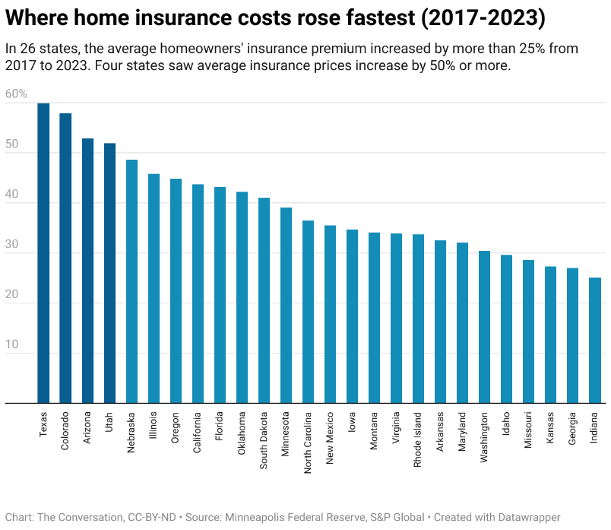
Flood Risk Transfer & Financing
In Houston, a 100-year extreme event is now a 1-in-23-years event (Hurricane Harvey, 2017)
Insurance costs have raised on average 34 % (2017 – 2023)
Insurance is a Complementary FRM Measure, but it’s NOT a Sustainable Solution
People need to be responsible for their own resilience (homes and private companies)
Italy, from 01/01/2025 Mandatory Natural Disaster Insurance (Companies, then houses)

Slide 22
CONSULTATION PROCESS
Stakeholder Engagement for Validation of the FRM Strategy & FRM Action Plan
(After reviewing and acknowledgment from Drin CORDA - EWG)

Slide 23
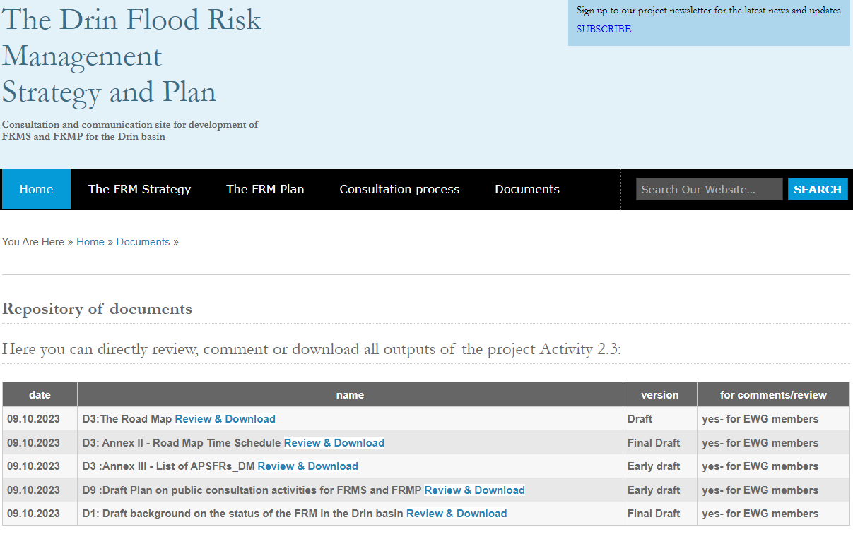
Communication Plan - floods.drinbasin.org

Slide 24
THANKS FOR ATTENTION
Doubts or Clarifications ?

